Slide 1


Erik DuCharme
December 3, 2024

Slide 2

Outline
Executive Summary
Introduction
Methodology
Results
Conclusion
Appendix

Slide 3
Executive Summary
Summary of methodologies
Data Collection through API
Data Collection with Web Scraping
Data Wrangling
Exploratory Data Analysis with SQL
Exploratory Data Analysis with Data Visualization
Interactive Visual Analytics with Folium
Machine Learning Prediction
Summary of all results
Exploratory Data Analysis result
Interactive analytics in screenshots
Predictive Analytics result

Slide 4
Introduction
Project background and context
Space X advertises Falcon 9 rocket launches on its website with a cost of 62 million dollars; other providers cost upward of 165 million dollars for each rocket, much of the savings is because Space X can reuse the first stage of its rockets. Therefore, if we can determine if the first stage will land, we can determine the cost of a launch. This information can be used if an alternate company wants to bid against space X for a rocket launch. This goal of the project is to create a machine learning pipeline to predict if the first stage will land successfully, and in doing so will save Space X money.
Problems you want to find answers
What factors determine if the rocket will land successfully?
The interaction amongst various features that determine the success rate of a successful landing.
What operating conditions needs to be in place to ensure a successful landing program.

Slide 5

Section 1

Slide 6
Methodology
Executive Summary
Data collection methodology:
The data was collected by using SpaceX API, as well as web scraping from Wikipedia
Perform data wrangling
One-hot encoding was applied to categorical features
Perform exploratory data analysis (EDA) using visualization and SQL
Perform interactive visual analytics using Folium and Plotly Dash
Perform predictive analysis using classification models
How to build, tune, evaluate classification models

Slide 7
Data Collection
The data was collected using various methods
Data retrieval was accomplished through a GET request to the SpaceX API
The response content was parsed into JSON format using the .json() method and transformed into a pandas DataFrame via the .json_normalize() function
Subsequently, the data was preprocessed, checked for missing values, and imputed where necessary to ensure completeness
Additionally, web scraping was conducted on Wikipedia to gather Falcon 9 launch records using BeautifulSoup
This involved extracting the relevant HTML table, parsing its content, and converting it into a pandas DataFrame for further analysis.

Slide 8
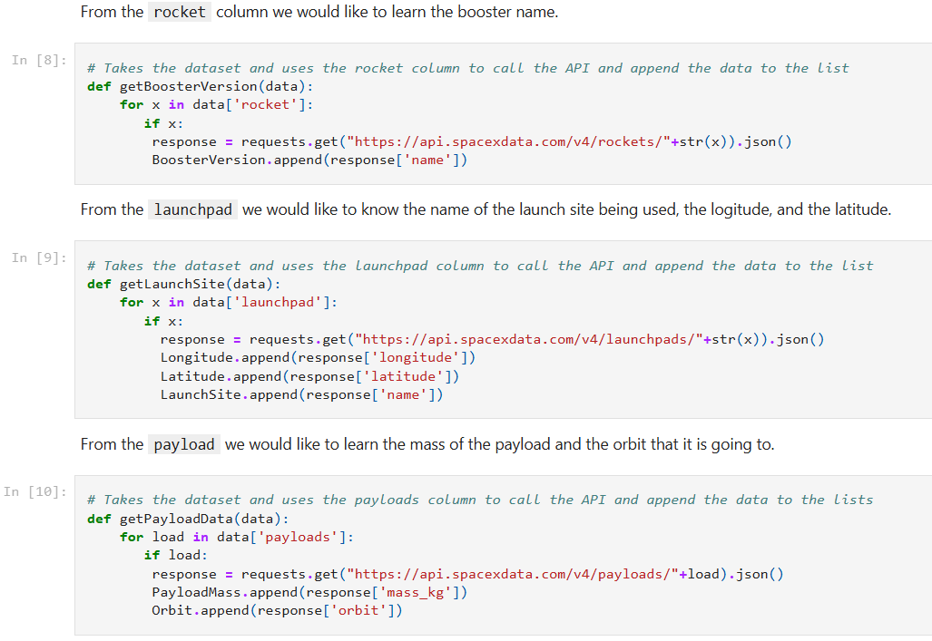
Data Collection – SpaceX API
I used the get request to the SpaceX API to collect data, clean the requested data and did some basic data wrangling and formatting
Visit my Github: http://https://github.com/educh18/IBM-Course-10-Capstone/blob/main/Module%201-data-collection-api%20(1).ipynb

Slide 9

Data Collection - Scraping
I then webscraped Falcon 9 launch records with BeautifulSoup
The table was parsed and converted it into a pandas dataframe.
Visit my Github: http://https://github.com/educh18/IBM-Course-10-Capstone/blob/main/Module%201-webscraping.ipynb

Slide 10

Data Wrangling
Conducted exploratory data analysis to define the training labels
Analyzed the data to calculate the number of launches per site and the frequency of each orbit type
Derived the landing outcome label from the outcome column and saved the results as a CSV file
Add the GitHub URL of your completed data wrangling related notebooks, as an external reference and peer-review purpose

Slide 11
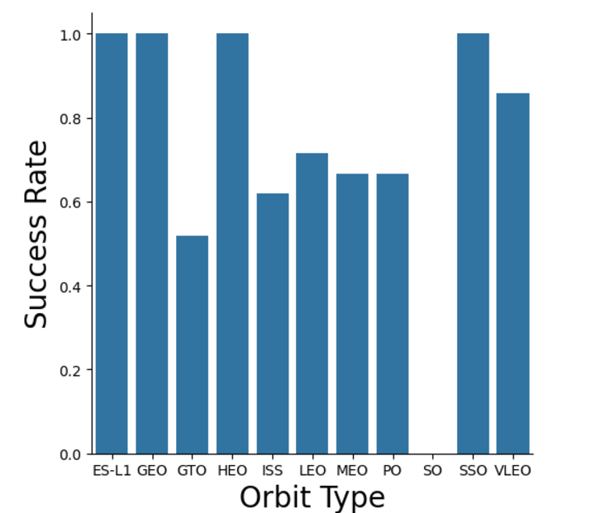
EDA with Data Visualization
I then examined the relationship between data such as flight number, launch Site, payload and launch site, success rate of each orbit type, flight number and orbit type, the launch success yearly trend, and created visualizations.
Visit my Github: https://github.com/educh18/IBM-Course-10-Capstone/blob/main/Module%202%20-%20Exploring%20and%20Preparing%20Data.ipynb

Slide 12
EDA with SQL
I then loaded the SpaceX dataset into a PostgreSQL database without leaving the jupyter notebook and applied EDA with SQL to get insight from the data. Some of the queries included:
The names of unique launch sites in the space mission.
The total payload mass carried by boosters launched by NASA (CRS)
The average payload mass carried by booster version F9 v1.1
The total number of successful and failure mission outcomes
The failed landing outcomes in drone ship, their booster version and launch site names.
Visit my Github: https://github.com/educh18/IBM-Course-10-Capstone/blob/main/Module%202-sql-coursera_sqllite.ipynb

Slide 13
Build an Interactive Map with Folium
Plotted all launch sites on a Folium map and added visual elements like markers, circles, and lines to represent the success or failure of launches at each site
Classified launch outcomes into binary features: class 0 for failures and class 1 for successes
Used color-coded marker clusters to analyze and identify which launch sites showed higher success rates
Measured the distances from each launch site to nearby infrastructure, such as railways, highways, and coastlines
Investigated questions like whether launch sites are situated near key infrastructure (ex. highways) and maintain a safe distance from cities
Visit my Github: https://github.com/educh18/IBM-Course-10-Capstone/blob/main/Module%203-launch_site_location.ipynb

Slide 14
Build a Dashboard with Plotly Dash
I built an interactive dashboard with Plotly dash
I plotted pie charts showing the total launches by a certain sites, and I plotted scatter graph showing the relationship with Outcome and Payload Mass (Kg) for the different booster version.
My Github: http://https://github.com/educh18/IBM-Course-10-Capstone/blob/main/Module%204%20-%20Machine%20Learning%20Prediction.ipynb

Slide 15
Predictive Analysis (Classification)
The data was loaded using numpy and pandas. It transformed the data, and split our data into training and testing
Different machine learning models were built and tuned different hyperparameters using GridSearchCV
Accuracy was used as the metric for our model, improving the model using feature engineering and algorithm tuning.
This was found to be the best performing classification model.
Github: https://github.com/educh18/IBM-Course-10-Capstone/blob/main/Module%204%20-%20Machine%20Learning%20Prediction.ipynb

Slide 16
Results
Exploratory data analysis results
Interactive analytics demo in screenshots
Predictive analysis results

Slide 17

Section 2

Slide 18

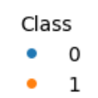
Flight Number vs. Launch Site
From the plot, we found that the more flights there are at a launch site, the greater the success rate at that site.

Slide 19
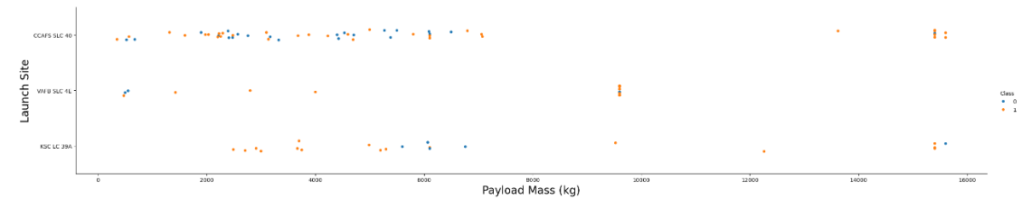
Payload vs. Launch Site
The higher the payload for launch site CCAFS LC-40, the higher the success rate of the launch

Slide 20

Success Rate vs. Orbit Type
From the plot, we can see that ES-L1, GEO, HEO, SSO, VLEO had the most success rates, while SO and GTO had the least successful rates

Slide 21

Flight Number vs. Orbit Type
The plot below illustrates the relationship between Flight Number and Orbit Type. In the LEO orbit, a correlation is observed between the number of flights and mission success. However, in the GTO orbit, no such relationship is evident between flight number and orbit

Slide 22

Payload vs. Orbit Type
I can observe that with heavier payloads, the successful landing are more for PO, LEO and ISS orbits, as opposed to lighter payloads.

Slide 23

Launch Success Yearly Trend
From the plot, we can see the success rate has kept increasing, on average, from 2013 until 2020

Slide 24
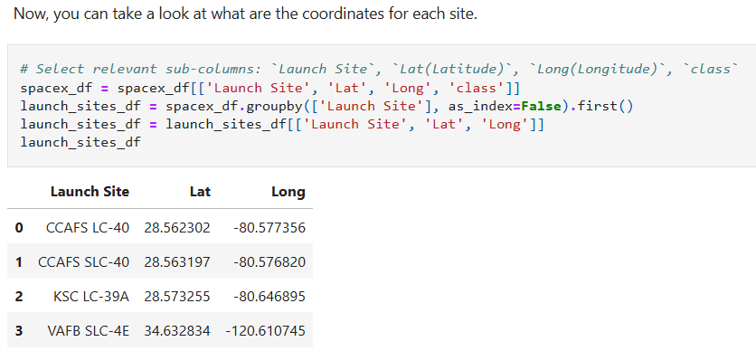
All Launch Site Names
The following are the four (4) launch sites and their coordinates

Slide 25

Launch Site Names Begin with 'CCA'
Find 5 records where launch sites begin with `CCA`

Slide 26

Total Payload Mass
The total payload carried by boosters from NASA was calculated to be 45,596 units

Slide 27

Average Payload Mass by F9 v1.1
The average payload mass carried by booster version F9 v1.1 was calculated to be 2928.4 units per launch

Slide 28

First Successful Ground Landing Date
I can see that the date of the first successful landing outcome on ground pad was 22nd December 2015

Slide 29

Successful Drone Ship Landing with Payload between 4000 and 6000
A WHERE clause was used to filter for boosters that had successfully landed on drone ship, and then an AND condition was applied to determine successful landing with payload mass greater than 4000 but less than 6000

Slide 30

Total Number of Successful and Failure Mission Outcomes
I used wildcard like ‘%’ to filter for WHERE MissionOutcome was a success or a failure.

Slide 31

Boosters Carried Maximum Payload
I determined the booster that have carried the maximum payload using a subquery in the WHERE clause and the MAX() function

Slide 32

2015 Launch Records
I used a combinations of the WHERE clause, LIKE, AND, and BETWEEN conditions to filter for failed landing outcomes in drone ship, their booster versions, and launch site names for year 2015

Slide 33

Rank Landing Outcomes Between 2010-06-04 and 2017-03-20
I selected Landing outcomes and the COUNT of landing outcomes from the data and used the WHERE clause to filter for landing outcomes BETWEEN 2010-06-04 to 2010-03-20.
I applied the GROUP BY clause to group the landing outcomes and the ORDER BY clause to order the grouped landing outcome in descending order.

Slide 34

Section 3

Slide 35

SpaceX World-Wide Launch Sites
Replace <Folium map screenshot 1> title with an appropriate title
Explore the generated folium map and make a proper screenshot to include all launch sites’ location markers on a global map
Explain the important elements and findings on the screenshot

Slide 36

Markers showing launch sites with color labels
Replace <Folium map screenshot 2> title with an appropriate title
Explore the folium map and make a proper screenshot to show the color-labeled launch outcomes on the map
Explain the important elements and findings on the screenshot

Slide 37

Launch Sites Distances to Nearby Landmarks

Slide 38

Section 4

Slide 39

Success Percentage Achieved By Each Launch Site

Slide 40

Launch Site With The Highest Launch Success Ratio

Slide 41

Scatter Plot of Payload vs Launch Outcome for All Sites, With Different Payload Selected in the Range Slider

Slide 42

Section 5

Slide 43

Classification Accuracy
The decision tree classifier is the model with the highest classification accuracy

Slide 44

Confusion Matrix
The confusion matrix for the decision tree classifier shows that the classifier can distinguish between the different classes. The major problem is the false positives .i.e., unsuccessful landing marked as successful landing by the classifier.

Slide 45
Conclusions
We can conclude that:
The larger the flight amount at a launch site, the greater the success rate at a launch site.
Launch success rates have increase from 2013 until 2020.
Orbits ES-L1, GEO, HEO, SSO, VLEO had the most success rate.
KSC LC-39A had the most successful launches of any sites.
The Decision tree classifier is the best machine learning algorithm for this task.

Slide 46


